Slide 1
Data Analytics and Visualisation Project Andre McQuaid (S00216958)
Development of a Data Visualisation Dashboard for Covid-19
https://covid-dashboard.shinyapps.io/Covid-Dashboard

Slide 2
Covid-19
Covid-19 was first discovered in Wuhan China in late 2019
Since then the impact of the pandemic has been huge
Over 5.5 million people have died from Covid-19 and there have been nearly 300 million cases
These figures are likely even higher as not all cases have been recorded
Analysing data related to Covid-19 is critical for us to be able to more fully understand and hence effectively tackle the pandemic

Slide 3
Proposal
The Center for Systems Science and Engineering (CSSE) at Johns Hopkins University (JHU) maintains a Covid-19 Data Repository
The goal of this project is to analyse, pre-process and consume this data with a view to developing a Shiny dashboard to report on Covid-19 cases and deaths
Shiny is an R package that makes it easy to build interactive web apps straight from the R statistical programming language
Learning Shiny is also a goal of this project

Slide 4
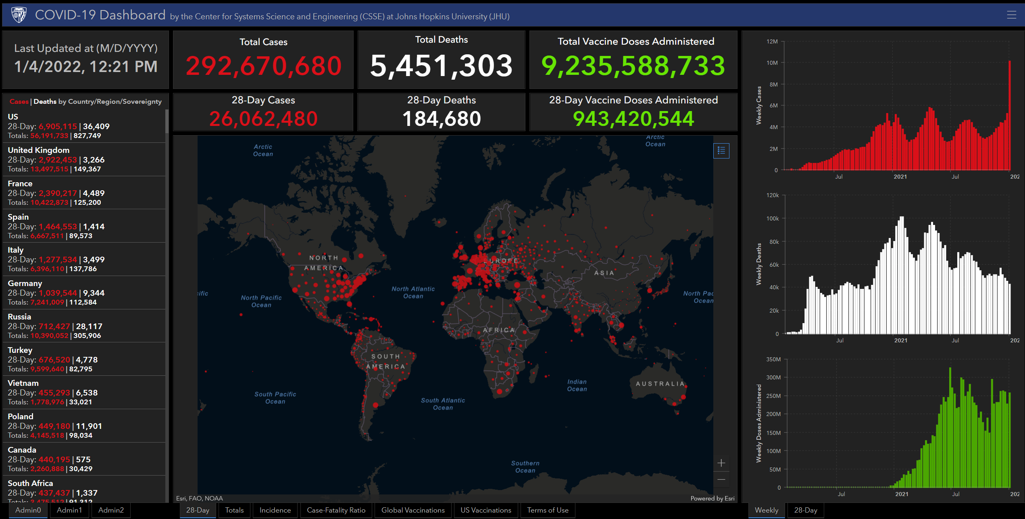
COVID-19 Dashboard The Center for Systems Science and Engineering (CSSE) at Johns Hopkins University (JHU)
The JHU dataset is trusted and is used extensively
For example, in the CSSE’s own Covid-19 dashboard available here
Lancet Article

Slide 5
JHU Covid-19 Data Schema
Field Name | Description
Date | Data snapshot date - MM-DD-YYYY.csv in UTC
Province/State | Province, state or dependency name
Country/Region | Country, region or sovereignty name.
Last Update | MM/DD/YYYY HH:mm:ss (24 hour format, in UTC)
Confirmed | Counts include confirmed and probable (where reported).
Deaths | Counts include confirmed and probable (where reported).
Recovered | Recovered cases are estimates based on local media reports
Latitude | Location Data
Longitude | Location Data

Slide 6
Data Preprocessing
Field Name | Description
Date | Date snapshot
Cases | Total number of cases
NewCases | Total number of new cases
Deaths | Total number of deaths
NewDeaths | Total number of new deaths
Country | Country name
NewCasesRolling7 | Rolling 7 day new cases average
NewDeathsRolling7 | Rolling 7 day new deaths avrerage
The JHU dataset is pre-processed using an R script to validate the data and then transform it into the following schema to facilitate use in the dashboard
The data has been processed (Data Preprocessing.R) from January 22nd 2020 up until 27th of December 2021

Slide 7
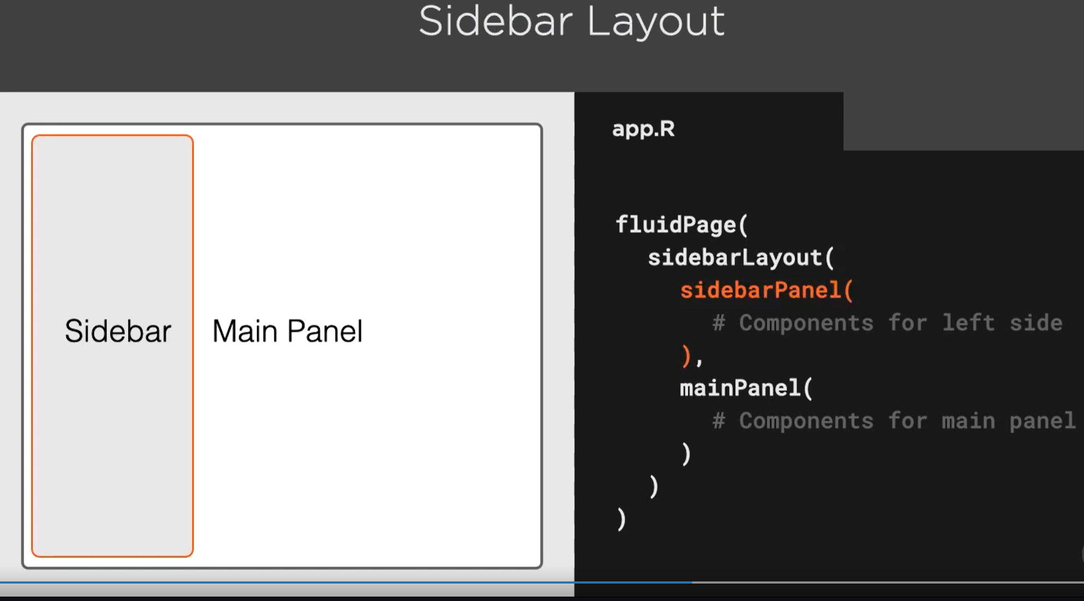
Shiny and R
Shiny is a powerful dashboarding technology that can natively leverage the power of R and its many packages, including graphical ones such as ggplot2
Shiny enables composition of user interface elements by embedding components within a tree-like structure starting with a high-level page
In this example, a fluidPage (fluid in that it can support dynamic user interfaces such as phone screens) contains a sidebar layout, that consists of a side bar and one main panel
Shiny dashboards can be easily built up and extended using this paradigm
The Shiny gallery contains many sample apps that can be used as the basis for new ones. Those in the Life Sciences section served as a basis for this app
Shiny apps can be authored and published to shinyapps.io from within Rstudio

Slide 8
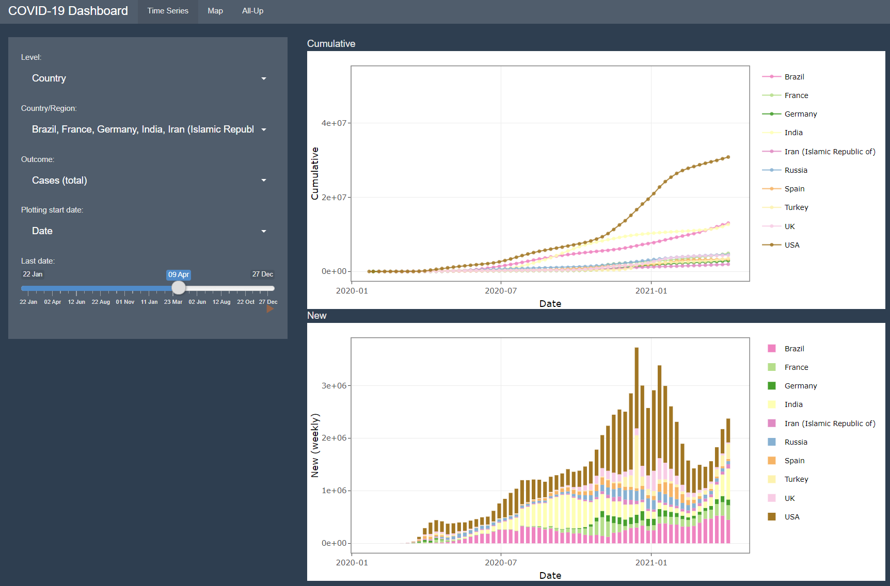
Time Series Tab
The time series tab can display country-specific Covid-19 metrics
Clicking the play button shows an evolution over time
Clicking on the play button enables animation

Slide 9
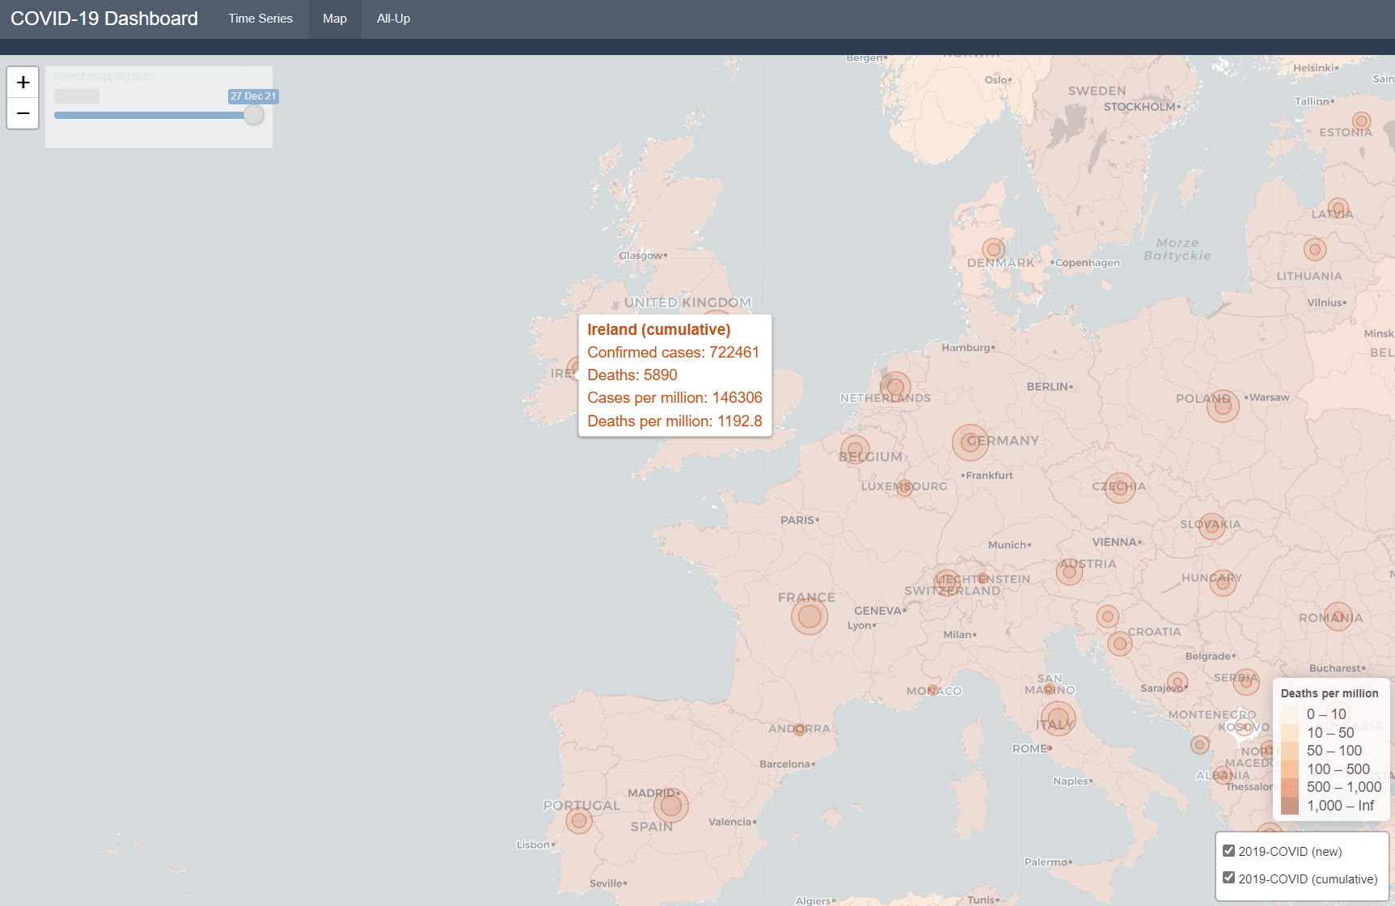
Map Tab
The map tab allows the user to visualise country-specific information by geographical location
The user can select a date
The user can pan and zoom

Slide 10
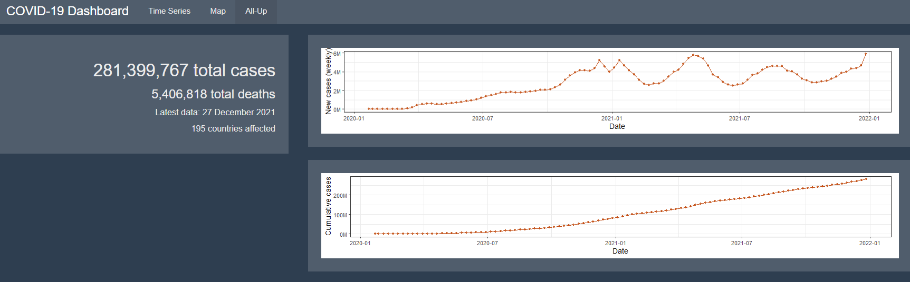

All Up Tab
The all-up tab displays higher-level aggregated information

Slide 11
Findings
Shiny is a powerful dashboarding package
It can leverage R’s statistical programming power
Shiny has access to the many R packages
It is well integrated into RStudio
Apps can be easily deployed to ShinyApps.io (App Link)
Shiny requires a deep understanding of R and RStudio
Debugging issues can be difficult

Slide 12
Dashboard Demo
The dashboard will be demoed: (App Link)
Happy to field any follow up questions via my ITSligo email address
Thank you!

